Slide 1
Provider Training Module
Screening and Management of Peripheral Neuropathy Using DPNCheck
© 2024 NeuroMetrix, Inc. PN2206097 Rev A

Slide 2
Learning Objectives
Pathophysiology and epidemiology of peripheral neuropathy
Gaps in clinical screening methods
Nerve conduction principles
DPNCheck device and how to interpret results
Strategies for working up patients with suspected peripheral neuropathy

Slide 3
Peripheral Neuropathy - Pathophysiology - Epidemiology - Clinical findings - Implications of delayed detection

Slide 4
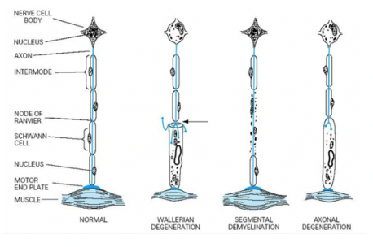
Peripheral neuropathy (polyneuropathy) is a systemic pathological change in peripheral nerves
Distinct from focal neuropathy
90%+ (in primary care) are distal symmetric polyneuropathy (DSPN, DSP)
Affect feet / lower legs first
Symmetrical symptoms/signs, sensory > motor
Chronic, slowly progressing
Occasional autonomic involvement
DSPN pathology
Primarily axonal degeneration
Both sensory and motor fibers usually affected
Maladaptive CNS changes (hyperalgesia, allodynia)
Complex pathogenesis*
Many causes including metabolic abnormalities, nutritional deficiencies, inflammation, toxins
*Oxidative stress, microvascular disease, impaired Na+/K+ ATPase activity, advanced glycation end products, mitochondrial dysfunction, axonal transport disruption, Schwann cell injury, inflammation, ion channel dysfunction

Slide 5
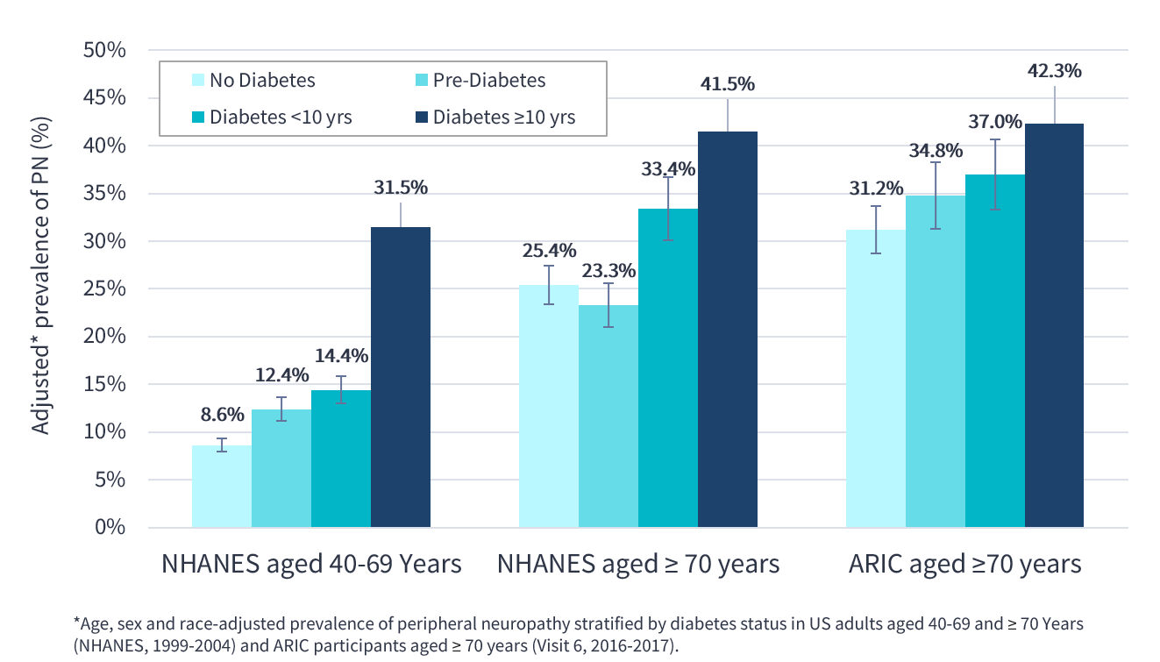
Approximately 30% of elderly patients have peripheral neuropathy
NHANES: 1999–2004 National Health and Nutrition Examination Survey
ARIC: 2016-2017 Atherosclerosis Risk
in Communities Study
References: Hicks et al. Sci Rep, 2021.

Slide 6
Peripheral neuropathy is associated with reduced quality of life, poor overall health & increased mortality
Peripheral neuropathy independently associated with all-cause mortality (HR 1.4*) and cardiovascular mortality (HR 1.3*)
Poor balance, unsteady gait and increased risk of falls
Unrecognized skin trauma → ulcers, amputation
Neuropathic pain
Mobility limitations
Muscle cramps
Lower extremity weakness
Charcot joints
falls
foot ulcers / amputation
neuropathic pain
*HR, hazard ratio.
References: Hicks et al. Ann Intern Med, 2021. Richardson and Hurvitz. J. Gerontoloy, 1996. Ward et al. Aging & Disease, 2016. Boulton et al. NEJM, 2004. Richardson and Hurvitz. J Gerontol, 1995. Cheng et al. J Clin Nurs, 2002. Erlandson et al. J Acquir Immune Defic Syndr, 2019. Riskowski et al. Journal of Foot and Ankle Research, 2012.

Slide 7
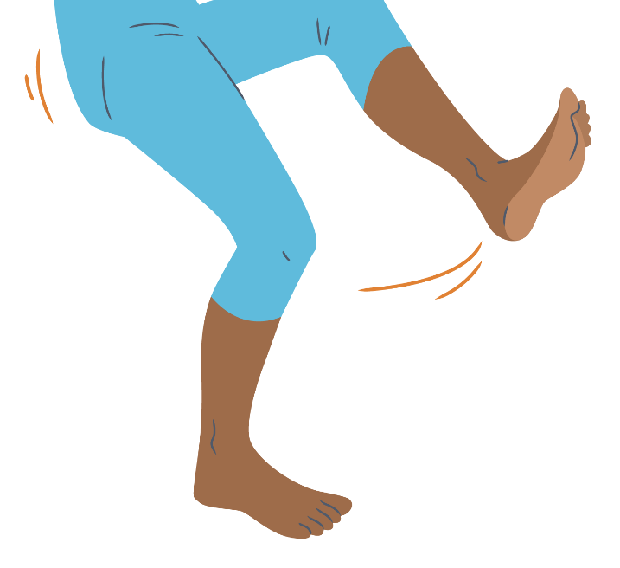
Peripheral neuropathy and increased risk of falls and fractures
Fall & fracture risk among adults 65 or older
25%
With Diabetes
18%
Without Diabetes
+39% greater
“Diabetic Peripheral Neuropathy is associated with a risk of major fractures due to falls” - Hicks CW, Selvin E. Epidemiology of Peripheral Neuropathy and Lower Extremity Disease in Diabetes
Callaghan B, et al. Neurology 2015
Longitudinal Patient-oriented Outcomes in Neuropathy - Importance of early detection and falls:
“We found that older adults with neuropathy have more falls and pain and lower self-rated health compared to carefully matched controls without neuropathy. These differences were present 3–5 years prior to a neuropathy diagnosis and persist for several years after diagnosis. Interventions to improve early peripheral neuropathy detection are needed.”

Slide 8
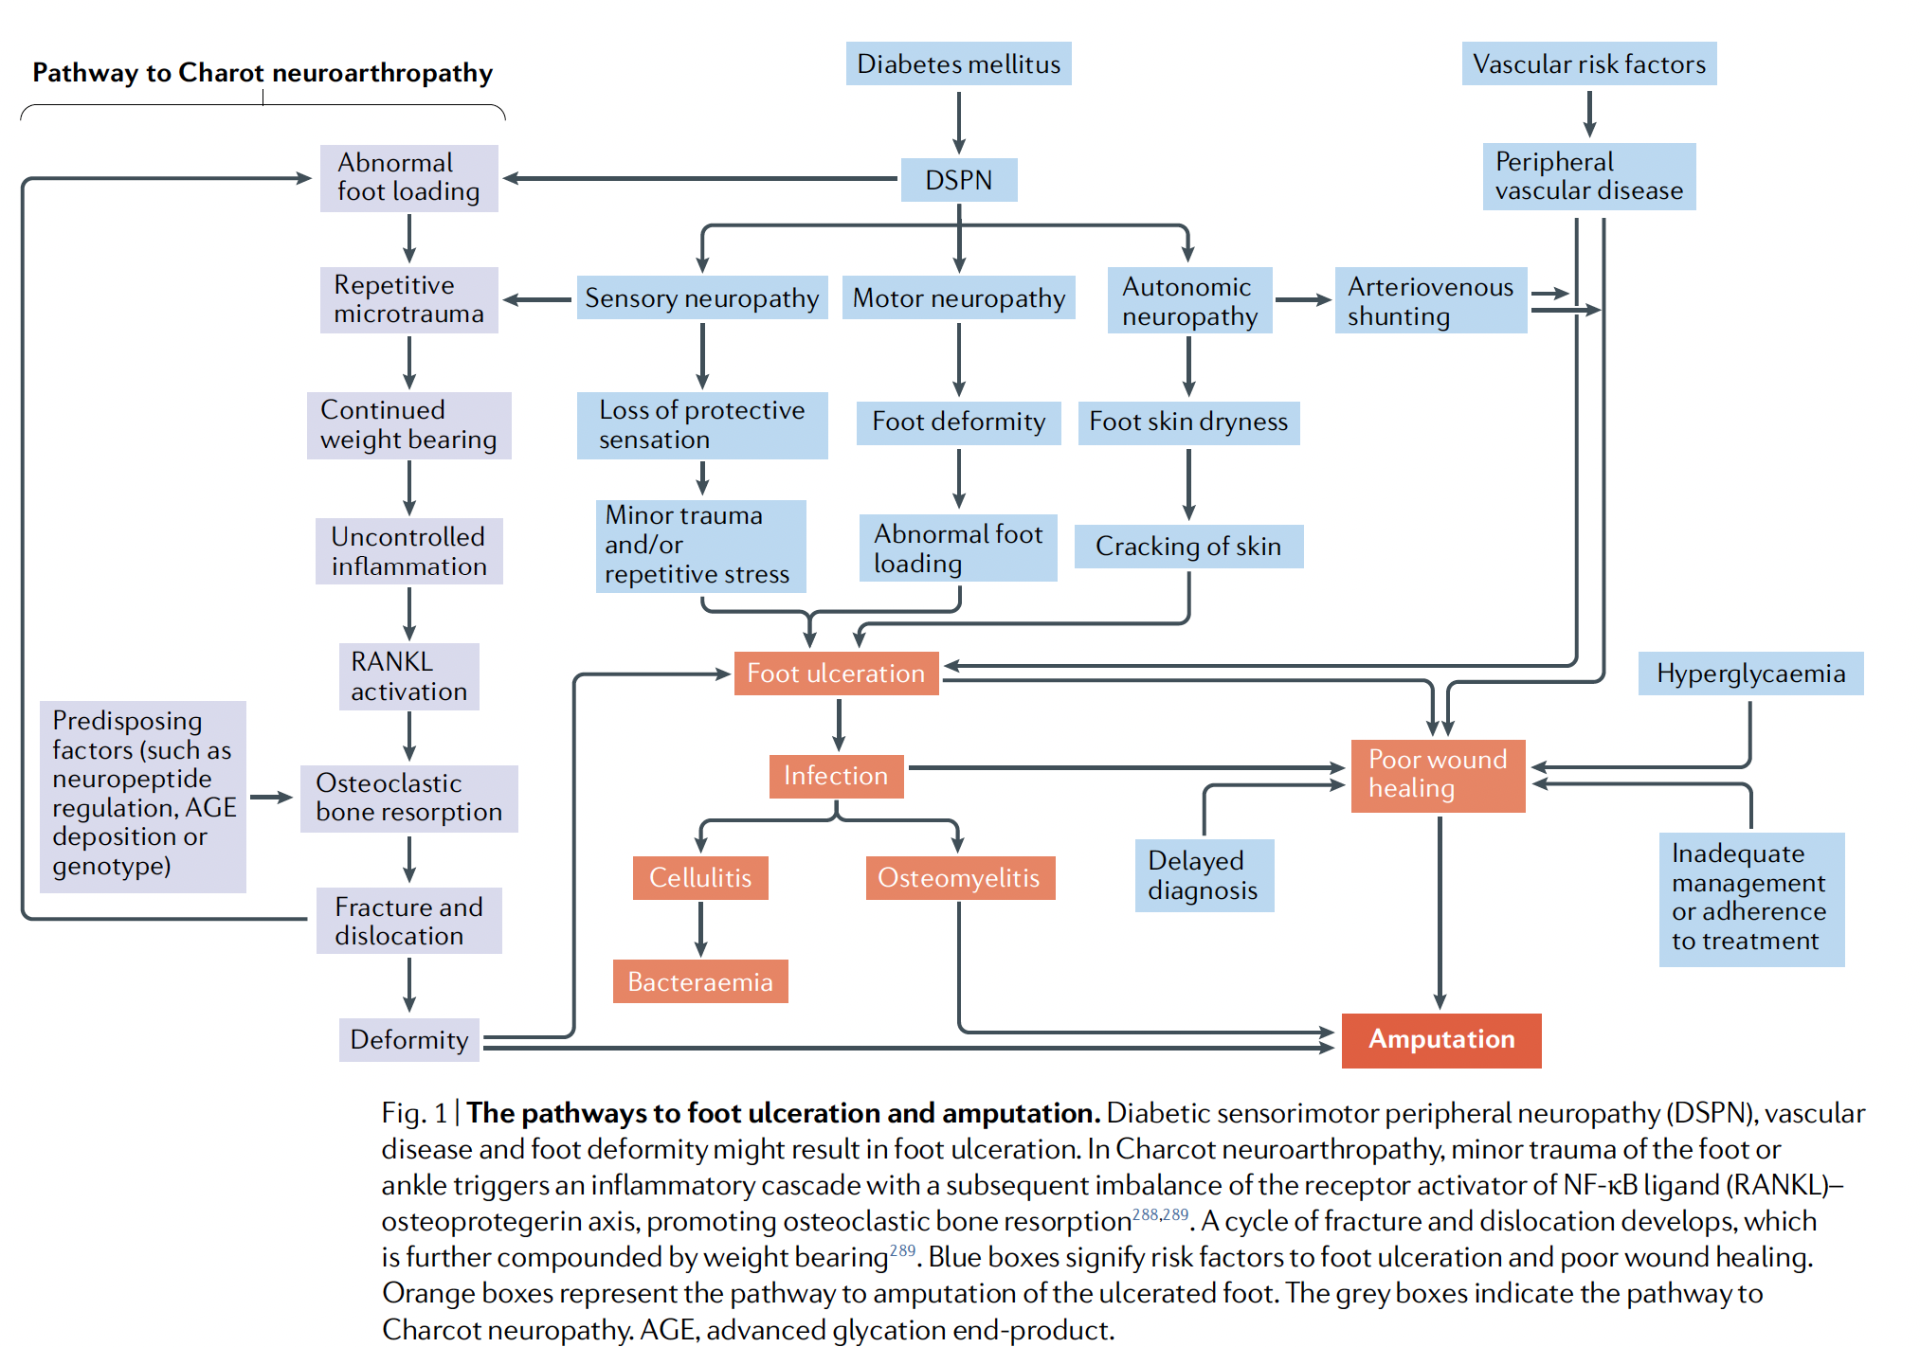
Diabetic peripheral neuropathy triggers a pathological cascade leading to foot ulceration and amputation
*
References: Sloan et al. Nature Reviews Endocrinology.

Slide 9
Peripheral Neuropathy as Predictive Indicator of Microvascular Complications
Suggests early asymptomatic detection is critical to patient outcomes
Ke, J et al. Diabetes, Metabolic Syndrome and Obesity 2023
A Nomogram for Predicting Vision-Threatening Diabetic Retinopathy (VTDR) Among Mild Diabetic Retinopathy (DR) Patients: A Case–Control and Prospective Study of Type 2 Diabetes:
Fukuda, T et al. Journal of Clinical Medicine 2023
Association between Diabetic Peripheral Neuropathy as Measured Using a Point-of-Care Sural Nerve Conduction Device and Urinary Albumin Excretion in Patients with Type 2 Diabetes
“Patients with DPNCheck-determined diabetic peripheral neuropathy had significantly higher urinary albumin excretion than those without…This finding suggests that DPNCheck could serve as a useful tool for identifying diabetic patients at risk for kidney damage, and may help to guide early interventions for both diabetic peripheral neuropathy and kidney complications.”
“In the current study, we combined Amp and CV and graded severity of SNCI [sural nerve conduction impairment] detected by DPN Check®, and the new finding indicated SNCI could be a strong predictor of VTDR. The roles of nerve damage in the pathophysiology of DR are worthy of further study.”

Slide 10
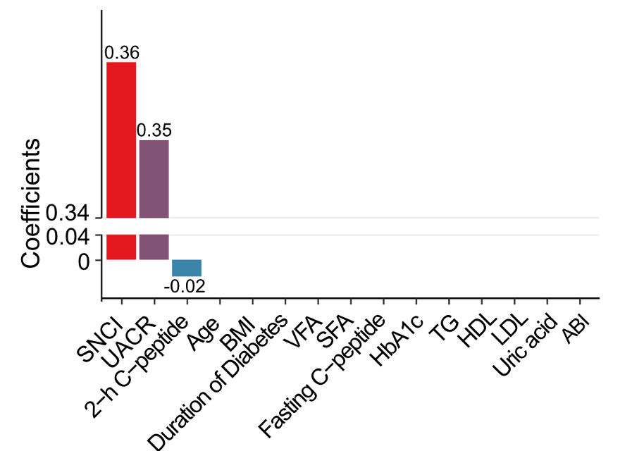
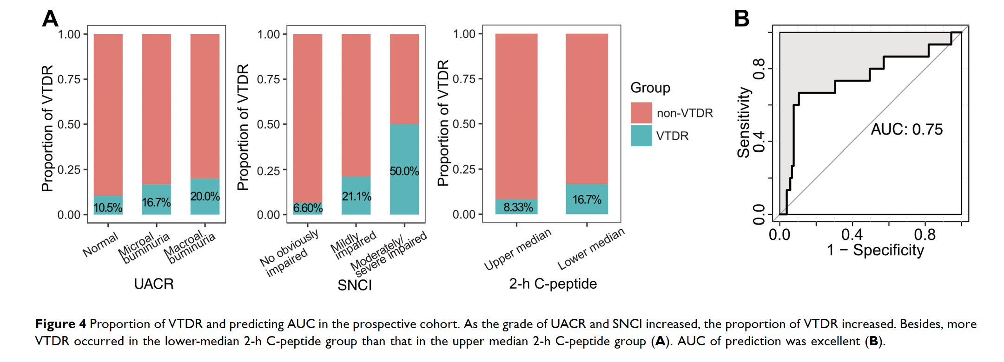
Predicting Vision-Threatening Diabetic Retinopathy: A case–control and prospective study of type 2 diabetes
It is difficult to predict who will progress from mild diabetic retinopathy (i.e., NPDR) to vision-threatening diabetic retinopathy (VTDR)
Study to identify predictors of progression (median of 42 months) from NPDR to VTDR
Predictors included Sural Nerve Conduction Impairment (SNCI) using DPNCheck, renal function (UACR), C-peptide, age, BMI, HbA1c, ABI and other laboratory measures.
The only independent predictors were DPNCheck, renal function and C-peptide.
Conclusion and Results:
SNCI (peripheral neuropathy) detected by DPNCheck is an independent predictor of VTDR
50% of patients who had moderate or severe peripheral neuropathy (PN) progressed from NPDR to VTDR
21% with mild PN progressed to VTDR
Only 6% of those without PN progressed
Ke, J et al. Diabetes, Metabolic Syndrome and Obesity 2023
doi:10.2147/DMSO.S394607
Detected and measured with DPNCheck

Slide 11
DPNCheck Test Results Predict Risk of Diabetic Nephropathy
“Accurately identifying and characterizing DPN may not only help to manage this debilitating condition more effectively, but also may be beneficial in identifying patients at risk for future declines in kidney function. “
- Fukuda T, et al. Journal of Clinical Medicine 2023 - doi: 10.3390/jcm12124089
Study evaluated the association of DPN with urinary albumin excretion (UAE) in patients with type 2 diabetes. UAE is an early diagnostic marker for kidney damage, another prevalent complication in diabetes.
Patients with DPNCheck®-determined diabetic peripheral neuropathy had significantly higher early diagnostic markers (UAE) for kidney damage than those without.
Other simplified diagnostic criteria revealed no difference in those same markers between patients with and without diabetic peripheral neuropathy.
Conclusion and Results:
Diabetic peripheral neuropathy (DPN) diagnosed using DPNCheck® is significantly associated with diabetic nephropathy.
DPN diagnosed with tuning fork or other simplified diagnostic criteria did not confer any predictive advantage
Study identifies the significance of detecting CV abnormalities early using DPNCheck® in patients at increased risk for kidney damage in diabetes.

Slide 12
Peripheral Neuropathy as Predictive Indicator of All-Cause Mortality
Suggests early asymptomatic detection is critical to overall patient outcomes
Goonoo, M S et al. Diabetes 2023
489-P: Abnormal Combined Point-of-Care-Device DPNCheck and SUDOSCAN Results Predict All-Cause Mortality in People with Diabetes. doi:10.2337/db23-489-P
“The prevalence of screen-detected DPN was 12.6% for 10g-MFT [monofilament test], 27.7% for TCNS [Toronto Clinical Neuropathy Score], and 33.4% for combined POCDs [point of care devices]. After adjusting for age, HbA1c and Total Cholesterol, only abnormal POCDs was significantly associated with all-cause mortality.
This is the first prospective study showing abnormal combined DPNCheck and SUDOSCAN results predict all-cause mortality after adjusting for other risk factors. However, 10g-MFT and TCNS that diagnose DPN late did not predict all-cause mortality.”

Slide 13
Screening for peripheral neuropathy - Limitations of traditional screening approaches - Importance of nerve conduction testing - Comparison of clinical screening and nerve conduction
13

Slide 14
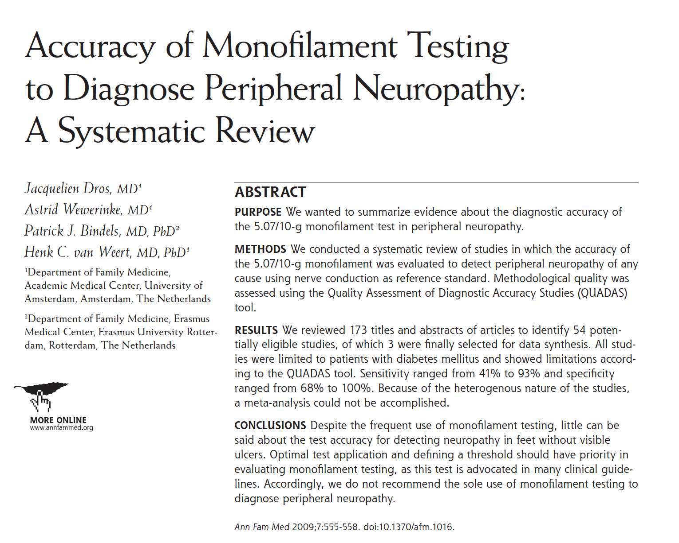
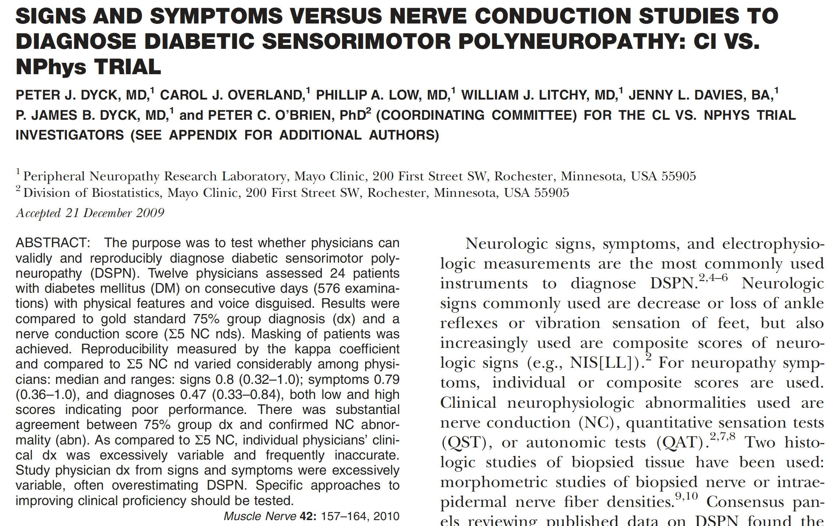
Clinical screening for peripheral neuropathy is subjective and diagnostically limited
“Despite the frequent use of monofilament testing, little can be said about the test accuracy for detecting neuropathy in feet without visible Ulcers … Accordingly, we do not recommend the sole use of monofilament testing to diagnose peripheral neuropathy.”
Traditional clinical approaches
10 g Semmes-Weinstein monofilament
128 Hz tuning-fork
Pinprick
Ankle reflexes
Symptoms
Issues with traditional testing methods
Do not localize disease to peripheral nerves
Detect late-stage disease (low sensitivity)
High variability
Psychophysical responses
Subjective, require patient compliance
Non-standardized, many different techniques
Not adjusted for patient demographics
Dros et al. Med. 2009.
“As compared to Σ5 NC [nerve conduction], individual physicians’ clinical dx was excessively variable and frequently inaccurate. Study physician dx from signs and symptoms were excessively variable, often overestimating DSPN.”
Dyck et al. 2010.
References: Dros et al. Ann Fam Med, 2009. Dyck et al. Muscle Nerve, 2010.

Slide 15
New Study Demonstrates Poor Diagnostic Accuracy of Monofilament Test for Diabetic Polyneuropathy (DPN)
“The monofilament test should not be used to diagnose DPN, nor be used as an inclusion tool in diabetes research.”
- Dunker, O et al. BMJ Open Diabetes Research & Care 2023 - doi: 10.1136/bmjdrc-2023-003545
Rigorous multi-center study conducted over 5 years to assess the diagnostic accuracy of the 5.07/10 g monofilament test (SWME) in 506 patients referred for polyneuropathy assessment
Nerve conduction study (NCS), considered gold standard, was used in reference standard
Now that modern point-of-care devices such as DPNCheck have become more cost-effective, investigators recommend reconsidering testing standards
Results and Conclusions: “This multicenter study demonstrates poor diagnostic performance for the 5.07/10g SWME in patients with diabetes referred to polyneuropathy assessments”
“The diagnostic accuracy of the SWME was not influenced by NCS-based disease severity, demonstrating that it does not perform better in patients with later stages of DPN.”
“Due to low sensitivity, almost half of patients with DPN are overlooked, diminishing the clinical value of a negative result.”
“In addition, receiving a true DPN diagnosis empowers the patient to take an active part in the disease management”

Slide 16
Traditional screening tests have low sensitivity for peripheral neuropathy compared to nerve conduction study (NCS)
Traditional methods may miss most mild and asymptomatic cases
100
3x
cases can be detected by NCS than by traditional methods if someone is asymptomatic.
Nerve Conduction
80
60
% Detected
(corrected for false positive rate)
Traditional Testing
Methods
54% NCS
17%
Traditional methods
40
vs
20
0
Source : Perkins, et.al., Diabetes Care 2001 doi:10.2337/diacare.24.2.250
adjusted for false positives

Slide 17
New Study Demonstrates Accuracy of DPNCheck’s Point-of-Care NCS vs. traditional NCS in the Diagnosis of Diabetic Polyneuropathy (DPN)
Simplified electrophysiological approach combining a point‐of‐care nerve conduction device and an electrocardiogram produces an accurate diagnosis of diabetic polyneuropathy - Hayashi et al. Journal of Diabetes Investigation 2024
Study goal was to establish if two simple point-of-care tests could reproduce results derived from more resource-intensive nerve conduction studies (NCS), considered gold standard.
167 subjects with type 1 and type 2 diabetes were tested with the DPNCheck and an EKG (reporting CVR-R*). A combination of two tests was intended to capture signs of sensorimotor (DPNCheck) and autonomic (CVR-R) neuropathy.
The predictive results from the two point-of-care tests exhibited good diagnostic accuracy: The area under the curve in receiver operating characteristic (ROC) analysis was 0.88.
Results and Conclusions: Investigators successfully verified that the diagnosis obtained from DPNCheck and CVR-R at the point of care could reproduce the diagnosis based on traditional NCS. In addition, similar performance was reported when using just DPNCheck to diagnose DPN.
“By combining these tests, we have developed an estimation formula with excellent diagnostic performance. The use of DPNCheck and electrocardiogram would simplify the diagnosis of diabetic polyneuropathy, making it more accessible, reproducible and reliable.”
*CVR-R: a coefficient of variation of R-R intervals, a standard value reported by EKG’s
https://doi.org/10.1111/jdi.14174

Slide 18
Nerve conduction principles - Nerve conduction studies as gold standard - Components of NCS results - Why test sural nerve
18

Slide 19
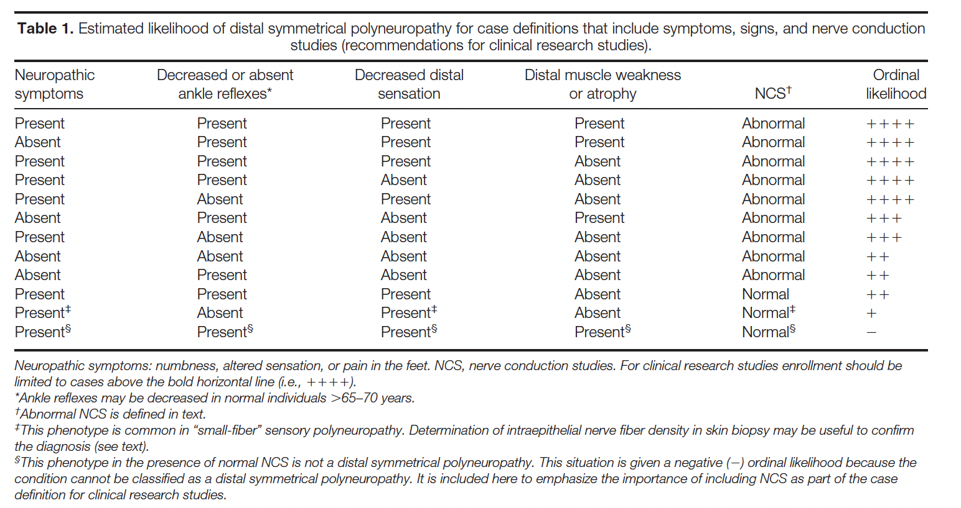
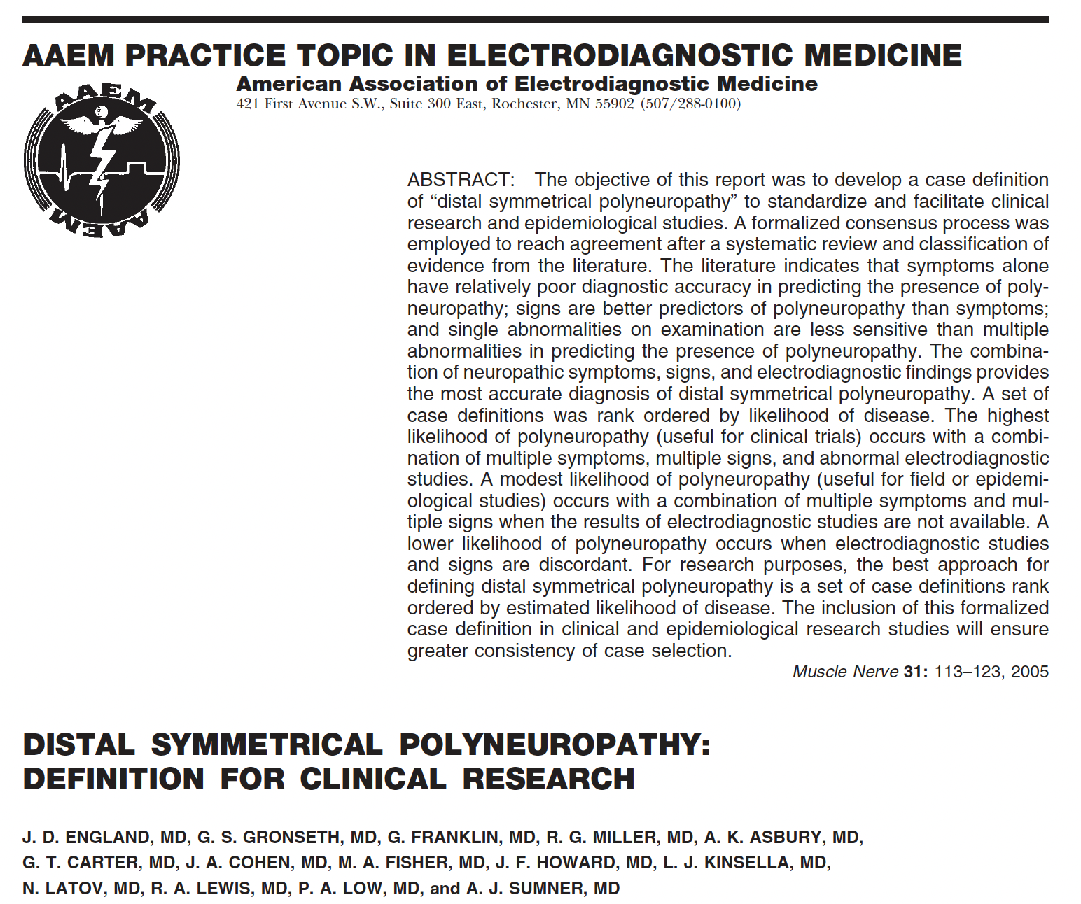
Nerve conduction is the gold standard diagnostic test for peripheral neuropathy - Position statement of American Academy of Neurology, AANEM, AAPM&R
Likelihood of Peripheral Neuropathy
AANEM, American Association of Neuromuscular & Electrodiagnostic Medicine. AAN, American Academy of Neurology. AAPM&R, American Academy of Physical Medicine and Rehabilitation.
References: England et al. Muscle Nerve, 2005.

Slide 20
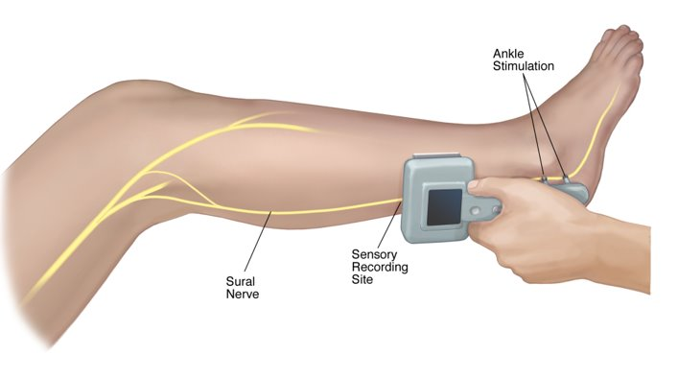
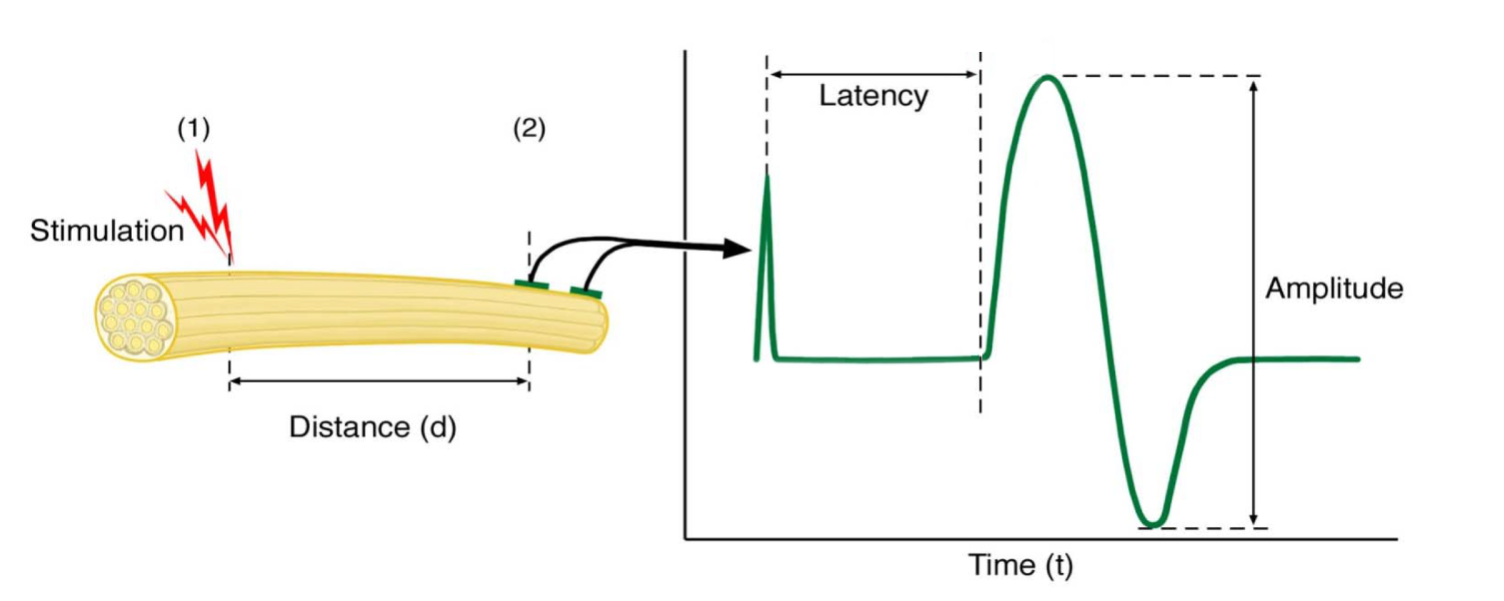
Nerve conduction is the measurement of action potential propagation in peripheral nerves
1
2
Sensory Nerve Action Potential
Nerve conduction measures the large myelinated axons (Aα, Aβ)
Conduction Velocity = Distance / Latency

Slide 21
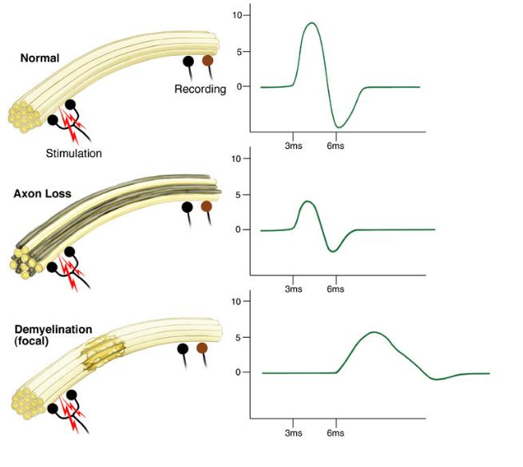
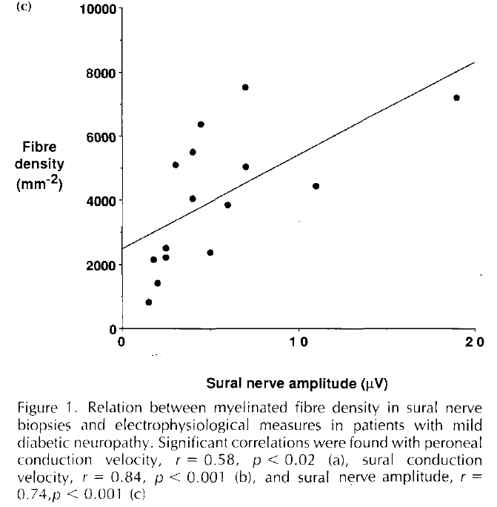
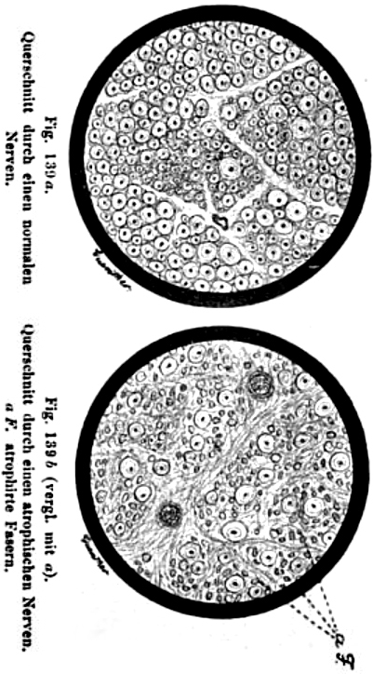
Sensory nerve amplitude correlates with nerve fiber density
“Virtual Nerve Biopsy”
Oppenheim. Textbook of nervous disease.. 1894.
© 2005 NeuroMetrix, Inc.
References: Veves et al. Diabetic Medicine 1991.

Slide 22
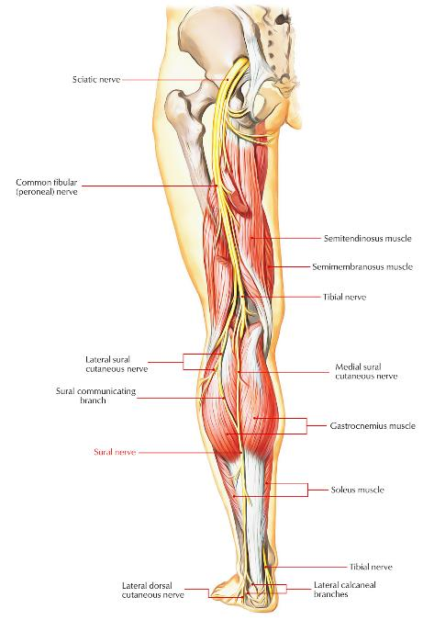
Sural nerve conduction is a sensitive and specific indicator of distal nerve fiber loss
Neuroanatomy
Distal sensory nerve
Comprised of branches from the tibial and common fibular nerves
Supplies sensation to the skin of the lateral foot and lateral lower ankle
Sensitive indicator of distal nerve fiber loss
Abnormalities are specific for peripheral neuropathy
Unaffected by lumbosacral disc herniation
Focal neuropathy of sural nerve (or proximal fibers) uncommon
Sural nerve response is detectable in most non-neuropathic elderly patients

Slide 23
DPNCheck - Device overview - Interpretation of results - Quality control

Slide 24
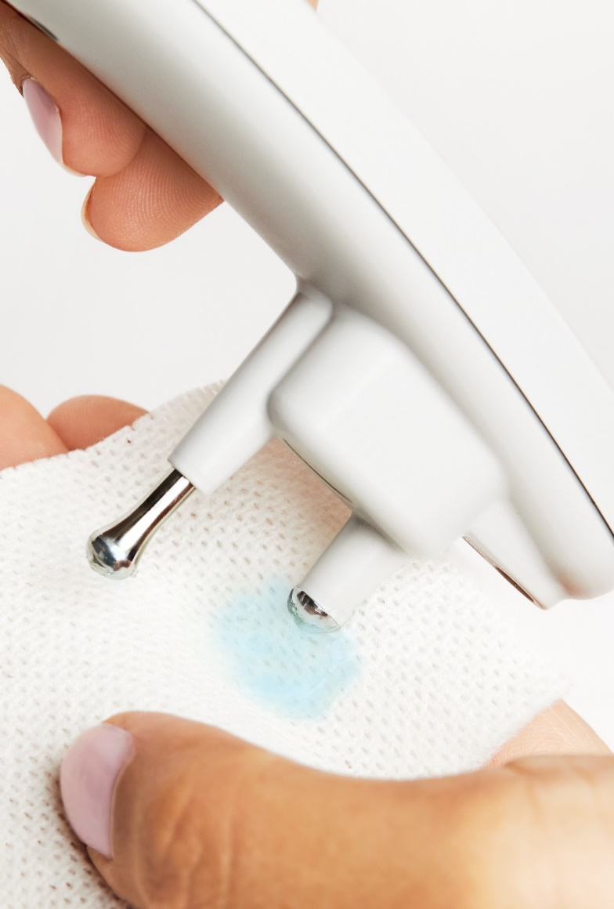
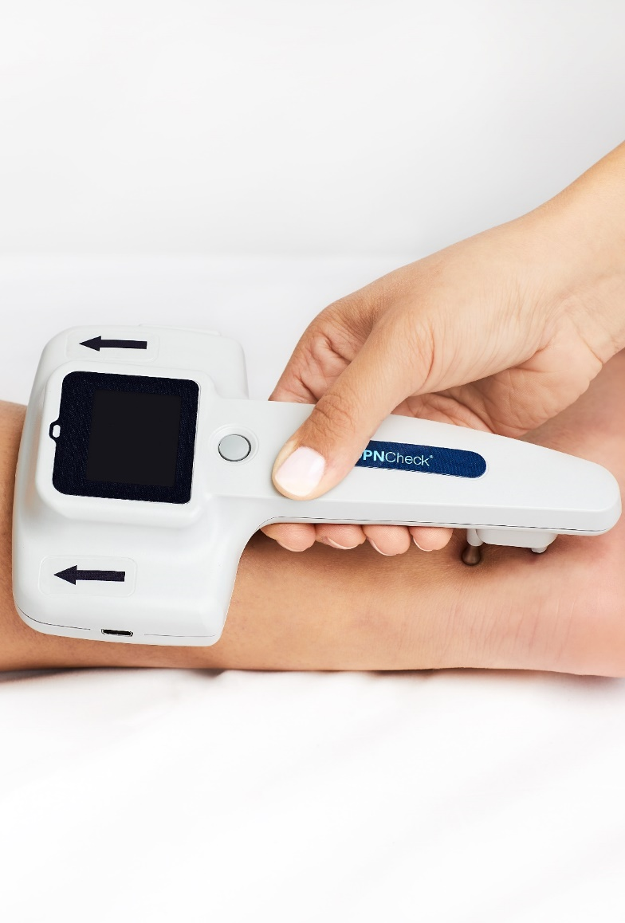
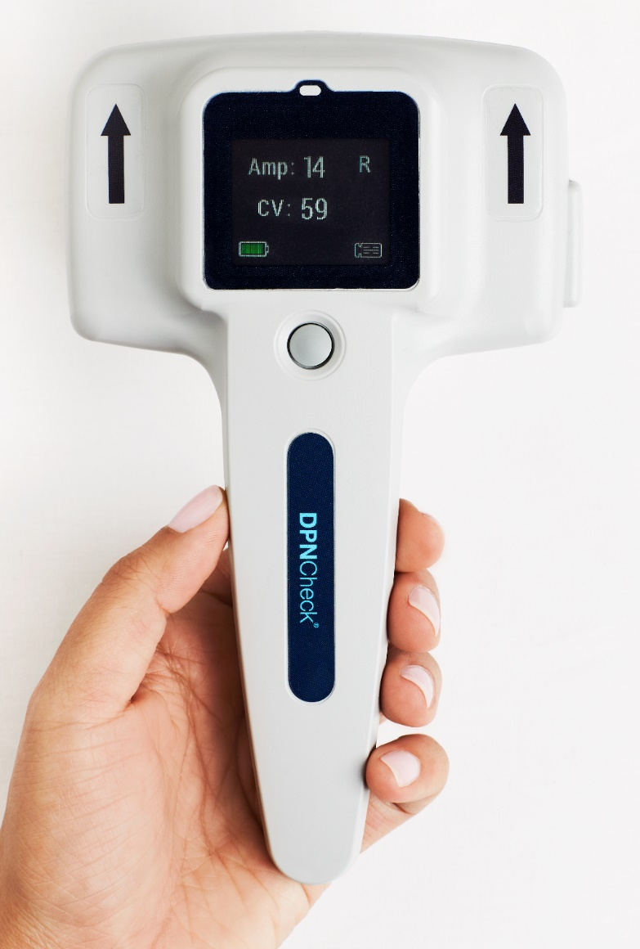
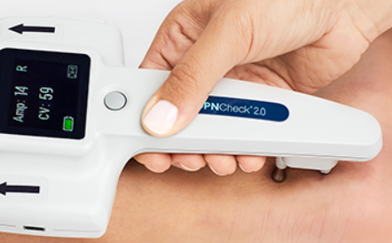
DPNCheck is a standardized and automated sural nerve conduction test
1
Testing in 4 Easy Steps:
Insert biosensor, apply gel
View results after 10-15 seconds
Position patient, prepare skin
Position device, start test
Performed in minutes by point-of-care staff
Gold standard NCS technology
Device + single-patient-use biosensor
Reports amplitude and conduction velocity
Straightforward interpretation
2M+ patients tested over 10 years

Slide 25
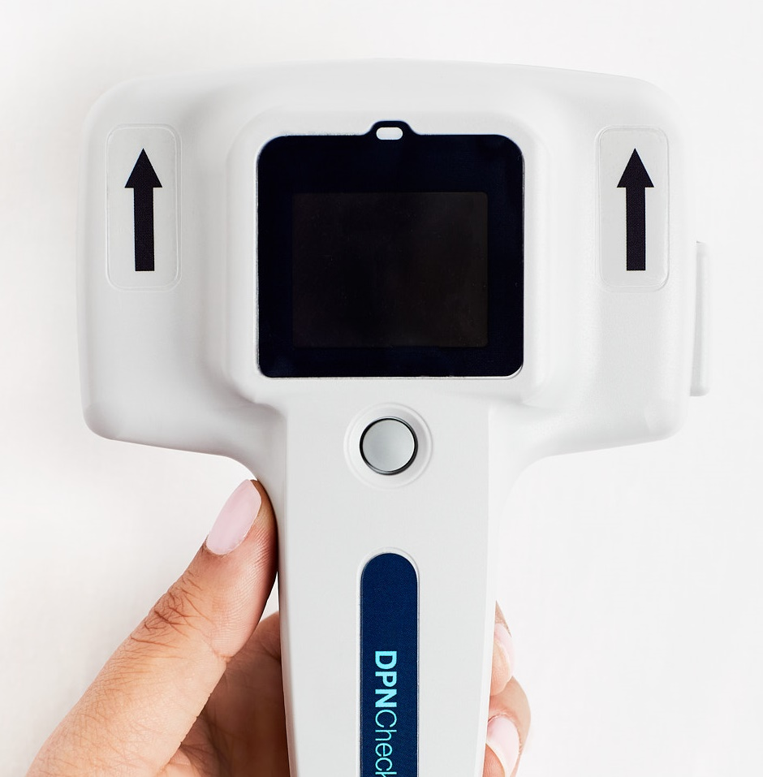
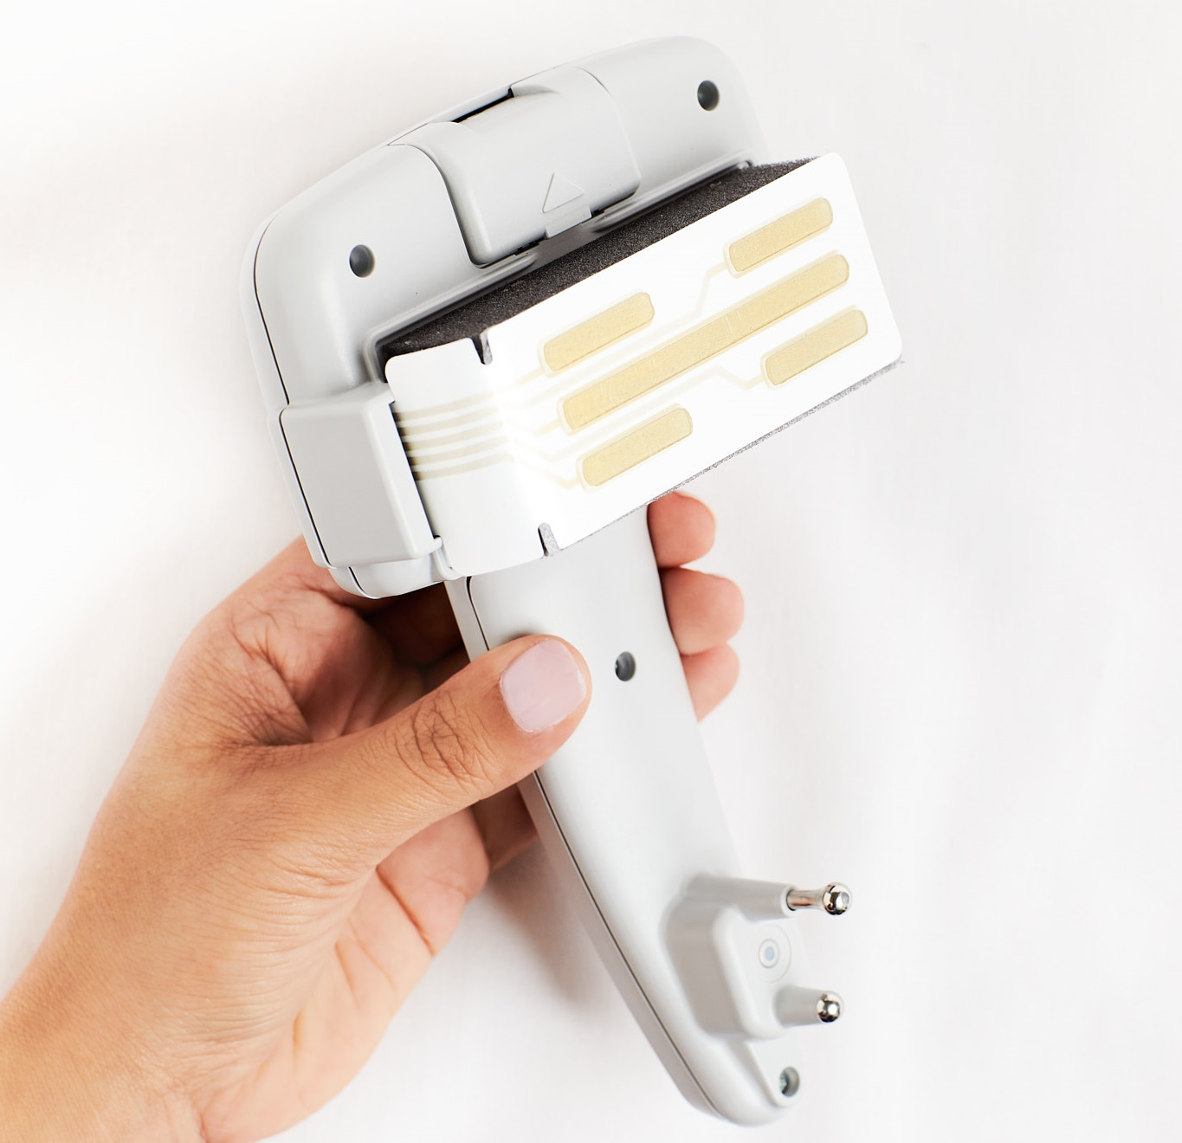
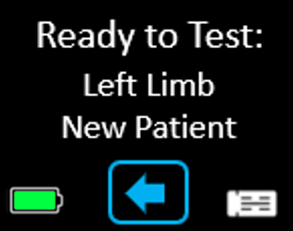
DPNCheck 2.0 Device Overview
Battery Compartment
LED Light
USB Port
Color Touchscreen
Biosensor Port
Single-use Biosensor
Power/Test Button
Stimulating Probes
Device Handle
Infrared Thermometer
Top Side
(tester facing)
Bottom Side
(patient facing)

Slide 26
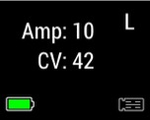
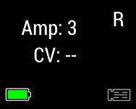
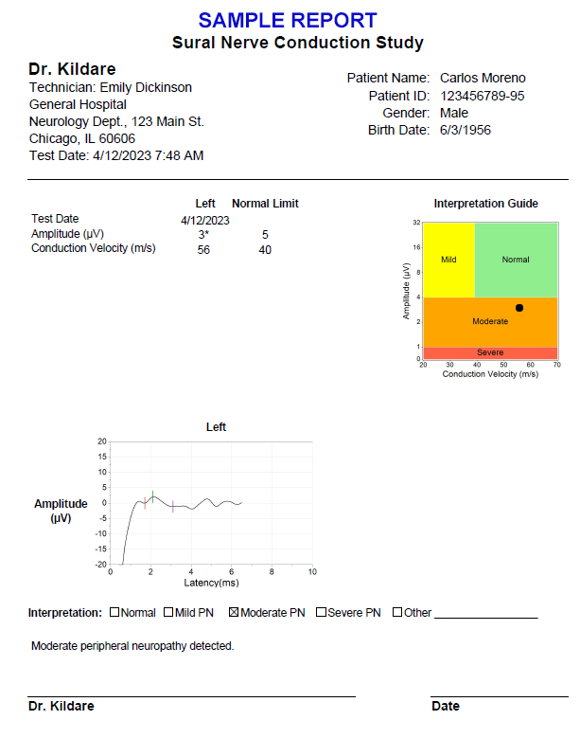
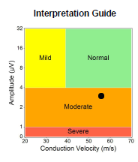
Interpretation of DPNCheck results is straightforward
Results, normal limits
Abnormalities indicated with *
Perform test to obtain results (3 possibilities – all valid)
Determine abnormalities.
Abnormal if value < normal limit or undetectable
Normal limit can be fixed or age/height adjusted
Interpret*
Amp + CV
Amp only
Undetectable
Interpretation guide
Peripheral Neuropathy | Amplitude | Conduction Velocity
No Neuropathy | Normal | Normal
Mild | Normal | Abnormal
Moderate | Abnormal | Normal / Abnormal
Severe | Undetectable
*Diagnosis of peripheral neuropathy is based on providers’ medical judgement and institutional protocols.

Slide 27
Interpretation examples
Age (Years) | Height (Inches) | Amplitude Result Normal Limit | Amplitude Normal Limit | Conduction Velocity Result Normal Limit | CV Normal Limit | Abnormalities | Interpretation*
65 | 60 | 12 | 5 | 53 | 47 | None | Normal
65 | 60 | 3 | 5 | 40 | 46 | Amp, CV | Moderate
85 | 72 | 3 | 3 | 40 | 38 | None | Normal
85 | 72 | 2 | 3 | 35 | 38 | Amp, CV | Moderate
85 | 72 | Undetectable** | 3 | -- | 38 | Undetectable | Severe
85 | 72 | 2 | 3 | -- | 38 | Amp | Moderate
*Diagnosis of peripheral neuropathy is based on providers’ medical judgement and institutional protocols.
**Undetectable indicates amplitude < 1.5 microvolts

Slide 28
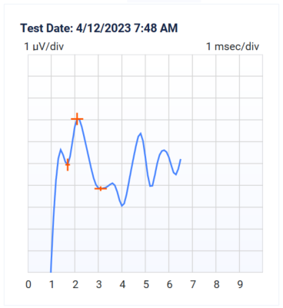
DPNCheck automated quality control helps confirm that reliable and valid nerve responses are acquired
Patient skin temperature is not too cold
Stimulators placed on skin without excessive gel
Biosensor placed directly on skin (e.g., liner removed)
Adequate stimulation intensity* to overcome edema, adipose tissue and neuropathy
Average at least 4 nerve responses
Confirm that nerve response is not contaminated by artifacts (e.g., stimulus, electrical interference, movement)
Confirm that correct limb was selected
*Up to 70 milliamps.

Slide 29
Patient Work-up - Assessment framework - Treatment and management plan - Patient management and engagement pathways - Quality measures and coding considerations

Slide 30
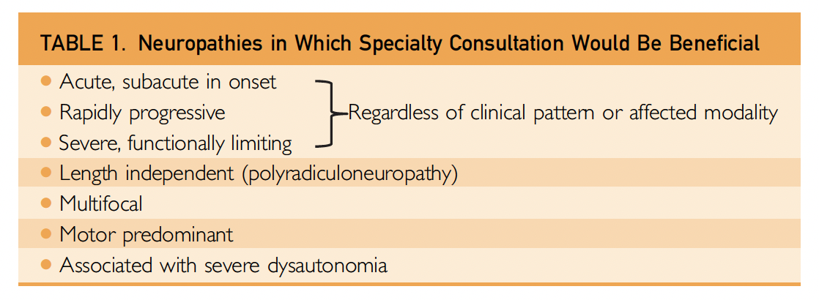
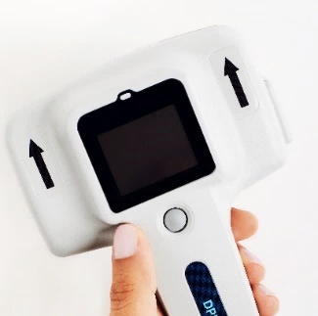
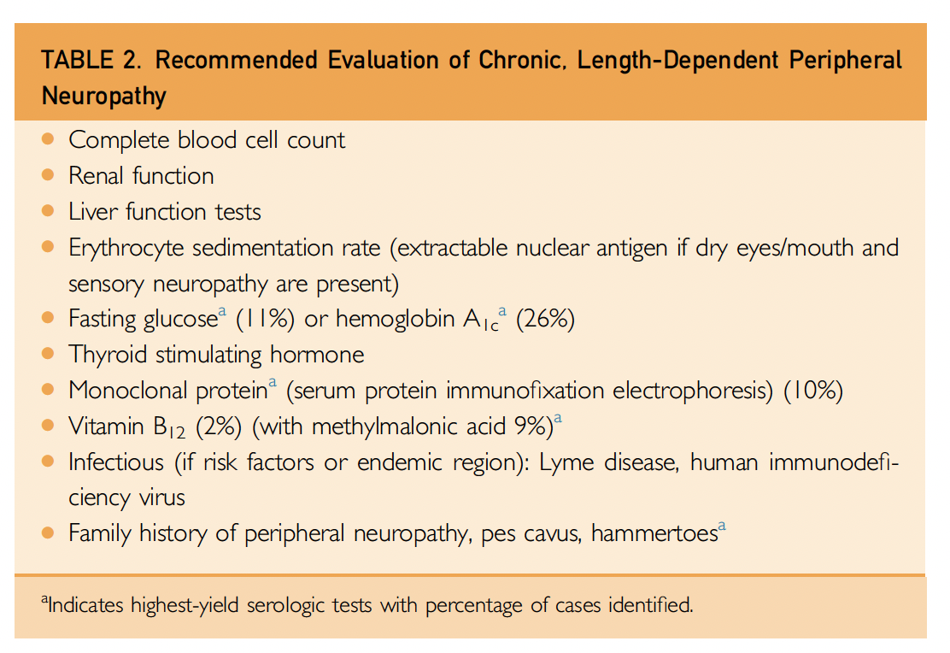
Patient Assessment Framework
Positive DPNCheck Screening Test
Clinical Evaluation (H&P)
R
Atypical Peripheral Neuropathy?
(see Table 1)
Determine Peripheral Neuropathy Etiology
(see Table 2 & next slide)
No
Yes
Consider Specialist Referral
Treatment & Management Plan
References: Watson and Dyck. Mayo Clin Proc, 2015.

Slide 31
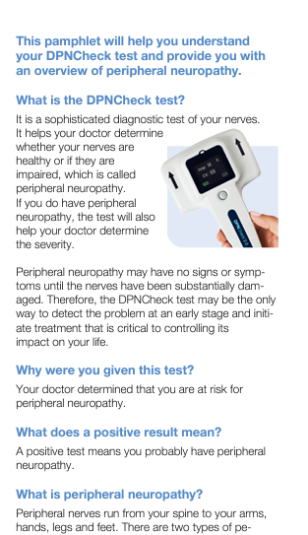
Peripheral neuropathy treatment and management
Patient education
Awareness of condition and implications
Educational brochure (see example)
Treat underlying disease (etiology)
Intensification of glucose control
Increase exercise/ reduce BMI
Remove toxin exposure
Treat symptoms
Neuropathic pain
Poor sleep
Anxiety, Depression
Risk mitigation
Fall prevention
Foot care
Referrals
Neurology
(atypical presentation)
Podiatry
(at-risk foot)
Hematology
(gammopathy)
Sample patient education materials
References: Doughty and Seyedsadjadi. The American J. of Medicine, 2018. Watson and Dyck. Mayo Clin Proc, 2015.

Slide 32
Patient Engagement and Management Pathways
Patient Engagement and Education:
Inform patient of their need to understand and manage the risks associated with peripheral neuropathy.
Provide materials such as the DPNCheck patient educational brochure
Patient Management:
Encourage focus on managing underlying disease - regulate glucose levels and encourage physical activity when feasible, with an aim to reducing BMI.
Foot care - instruct and encourage frequent foot self-checks, encourage use of supportive and well-fitting shoes, discourage going barefoot or socks-only
Pain management - discuss and explore pain management options that work best for patient.
Effective management of symptoms the American Academy of Neurology maintains a practice guideline that provides recommendations for managing neuropathic pain, including typical doses for medications practical use in clinic.
Ensure adequate sleep - if pain is interfering with sleep, discuss options.
Fall risk awareness and mitigation - advise patient to remove items that may be a tripping hazard around their home, suggest adding non-slip surfaces, improve lighting in home, and avoid going barefoot.
Enhanced monitoring for microvascular complications – recent research associates peripheral neuropathy with vision-threatening diabetic retinopathy (VTDR) and diabetic nephropathy. Consider closer monitoring of patients for these conditions.
Other approaches:
Consider Alpha Lipoic Acid supplementation, setting reasonable expectations for results with patient
Address possible non-diabetic causes; B12 repletion therapy, alcohol cessation, etc.
Possible Referrals:
Neurology if atypical presentation occurs, podiatry, hematology (paraproteinemia)

Slide 33
American Academy of Neurology Distal Symmetric Polyneuropathy Quality Measures
Quality Measures | Potential Methods
Appropriate diagnosis
Documentation of neuropathic symptoms and signs | History & Physical Examination*
Electrodiagnostic studies | DPNCheck
Underuse of effective services
Diabetes/prediabetes screening | Fasting Blood Sugar, HbA1C, OGTT
Screening for unhealthy alcohol use | History
Quality of life/morbidity
Querying about pain and pain interference with function | History, Brief Pain Inventory (BPI) questionnaire
Querying about falls (past 12 mo) | History
*Neuropathic symptoms: numbness, altered sensation, or pain in the feet. Neuropathic signs: decreased or absent ankle reflexes, decreased distal sensation, and distal muscle weakness or atrophy.
References: England et al. Neurology, 2014.

Slide 34
DPNCheck is a recognized nerve conduction test with an associated CPT code 95905
DPNCheck is a sensory nerve conduction test that uses a preconfigured electrode array to measure sural response amplitude and conduction velocity and produces a patient-specific report for clinician interpretation.
The service performed by the DPNCheck is described by CPT 95905:
Motor and/or sensory nerve conduction, using preconfigured electrode array(s), amplitude and latency/velocity study, each limb, includes F-wave study when performed, with interpretation and report.
Screenings with DPNCheck are not typically covered. DPNCheck as a diagnostic test may be covered, but coverage will vary by insurance provider.

Slide 35
Corporate Office
NeuroMetrix, Inc. 4b Gill Street Woburn, MA 01801
For More Information
www.DPNCheck.com
Customer Service
+1 888 786 7287 | Mon–Fri, 9:00am–6:00pm EST
customerservice@neurometrix.com
© 2024 NeuroMetrix, Inc. | PN2206097 Rev A

Slide 36
APPENDIX: Additional Details, Studies, and Supplementary Information

Slide 37
Peripheral neuropathy is an independent risk for falling and fall severity
Peripheral Neuropathy
Fall Rate in Elderly
Decreased Sensation
Altered Proprioception (sense of body position and movement)
Weakness
Neuropathic Pain
45%
OR* 2.5
25%
Impaired postural stability
Unstable gait
Typical Rate Without Peripheral Neuropathy
Estimated Rate with Peripheral Neuropathy
Increased Fall Risk (OR 1.5 – 2.5*)
Increased Fall Severity
*OR, odds ratio.
References: Richardson and Hurvitz. J Gerontol, 1995. Cheng et al. J Clin Nurs, 2002. Erlandson et al. J Acquir Immune Defic Syndr, 2019. Riskowski et al. Journal of Foot and Ankle Research, 2012.

Slide 38
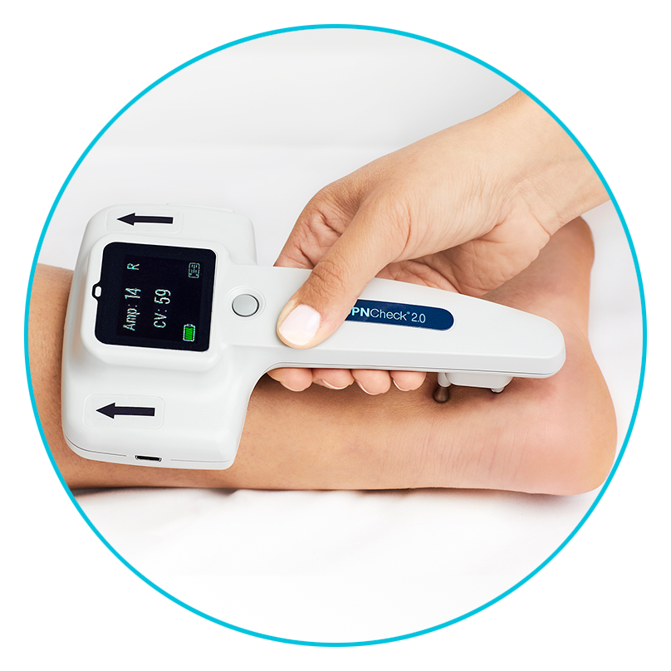
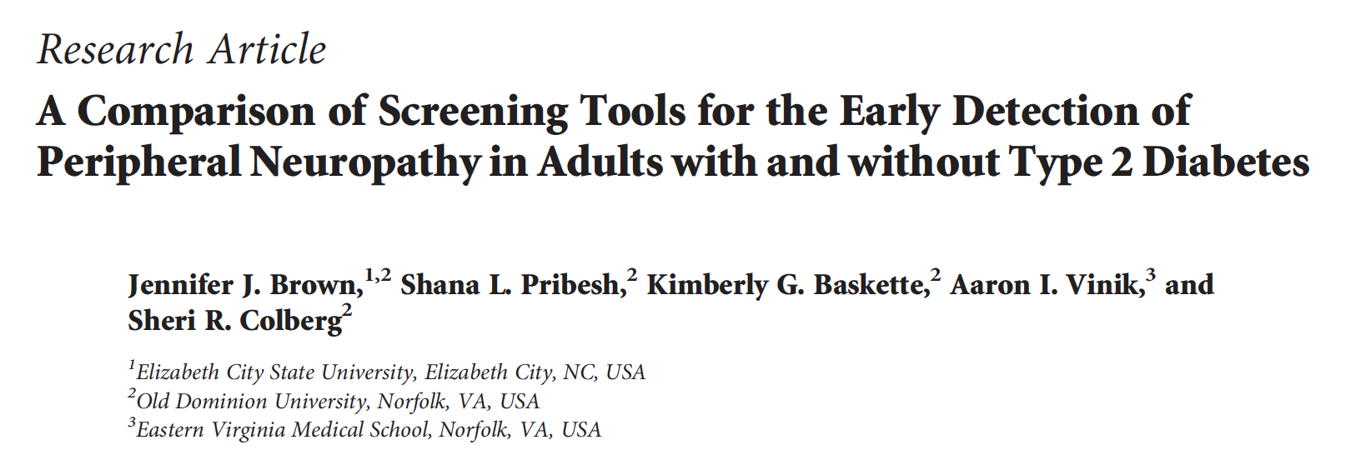
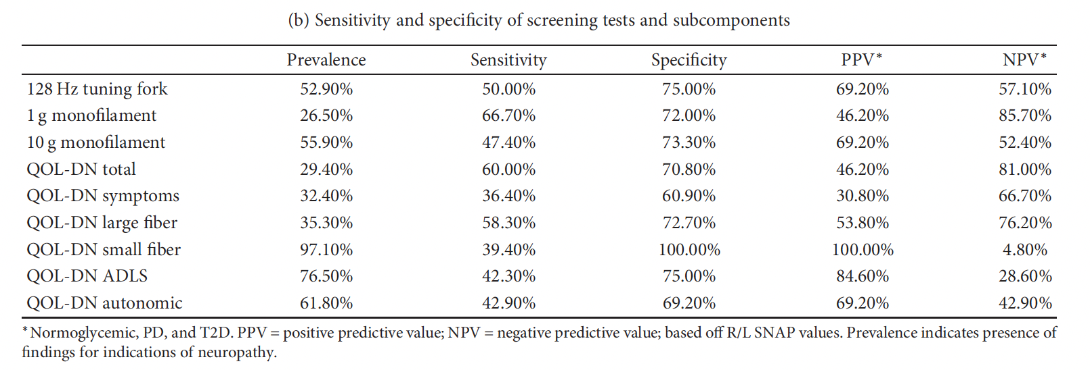
Monofilament and tuning fork only detect half of peripheral neuropathy cases identified by sural nerve conduction*
QOL-DN, Norfolk Quality of Life Diabetic Neuropathy questionnaire
*Performed with DPNCheck
References: Brown et al. Journal of Diabetes Research, 2017. Wang et al. Muscle Nerve, 2012. Baraz et al. J Diabetes Metab Disord, 2014.

Slide 39
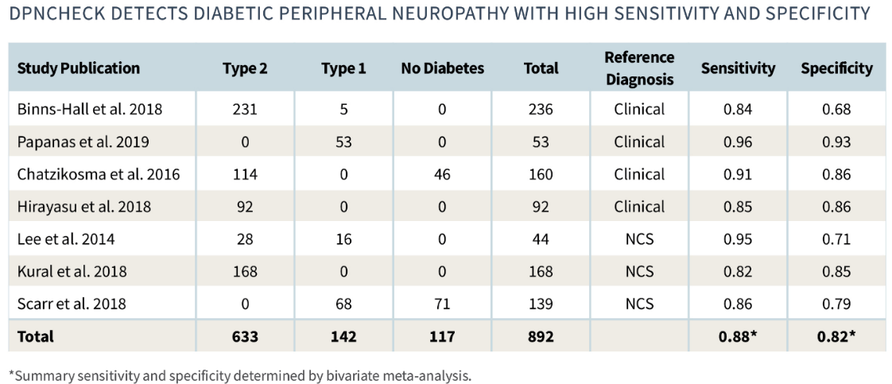
Seven independent studies on 892 subjects demonstrate that DPNCheck exhibits good diagnostic accuracy
Peripheral Neuropathy
Diabetes Type
Youden Index = 0.70
(effective diagnostic test has Youden Index > 0.50, Power et al. 2013)
Note: specificity when referenced against healthy controls is 95%
Youden Index = sensitivity + specificity – 1.
References: Power et al. Principles for high-quality, high-value testing. Evid Based Med, 2013.
Notes:
This slide summarizes the results of 7 recently published studies in high-quality peer-reviewed journals that evaluated the diagnostic accuracy of DPNCheck for detection of diabetic peripheral neuropathy. In total these studies evaluated about 900 subjects including individuals with Type 1 and Type 2 diabetes as well as non-diabetic controls. The reference standard for the diagnosis of peripheral neuropathy was either - established comprehensive clinical scales - or traditional nerve conduction studies as performed by neurologists.
As you can see, DPNCheck exhibited high diagnostic sensitivity in detecting peripheral neuropathy. About 9 out of 10 patients with peripheral neuropathy were identified with acceptable rates of false positives. It is important to point out that the reference diagnosis for peripheral neuropathy against which DPNCheck was compared is itself not-perfect, particularly the clinical methods, and therefore the actual performance of DPNCheck is likely better than that represented here.
This level of diagnostic performance is equivalent to the comparison of diagnostic assessment of neuropathies by two neurology laboratories. What this means for you in the clinic, is that you can can a high degree of confidence that DPNCheck is correctly identifying the peripheral neuropathy status of your patients.

Slide 40
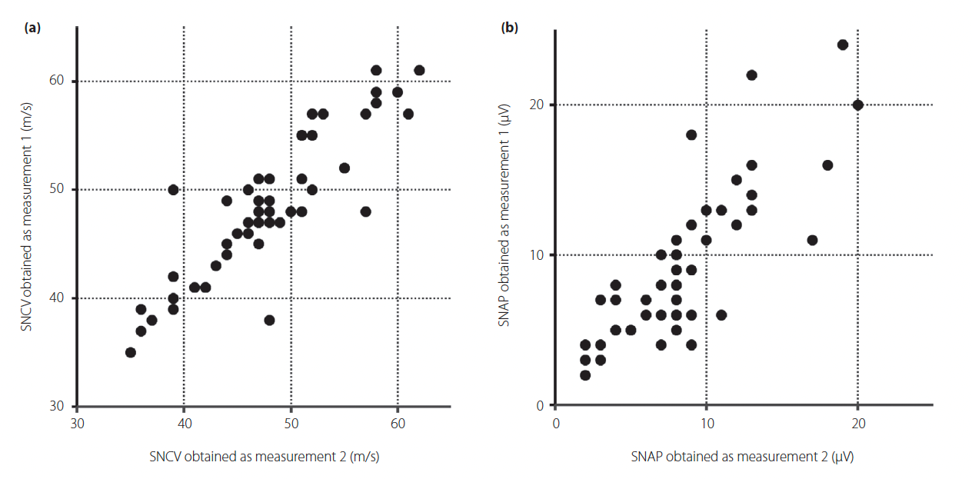
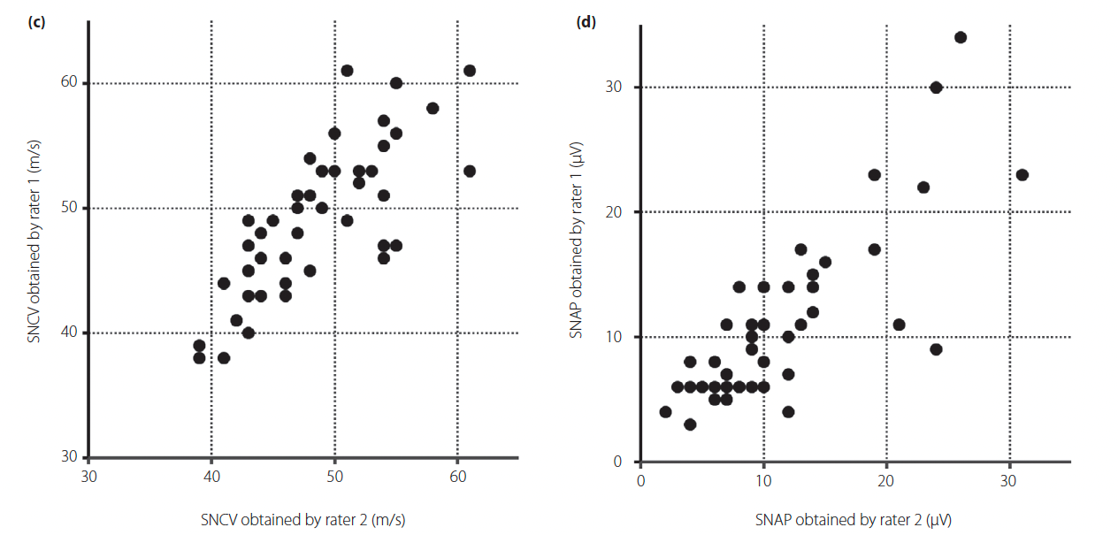
Two independent studies on 101 subjects demonstrate that DPNCheck exhibits good to excellent intra-rater and good inter-rater reliability
 |  |  |  | Intra-Rater (ICC) |  | Inter-Rater (ICC)
Reference | Population | Age | Sample Size | Amplitude | CV | Amplitude | CV
Lee et al. 2014 | Diabetes | 56 ± 18 | 44 | 0.97 | 0.94 | 0.83 | 0.79
Shibata et al. 2019 | Diabetes | 58 ± 14 | 57 | 0.84 | 0.88 | 0.81 | 0.78
Reliability scale (ICC)
Koo and Li 2017
1.00
excellent
0.90
good
0.75
moderate
0.50
Figure from Shibata et al. 2019.
poor
0.00
ICC, intraclass correlation coefficient.
References: Koo and Li. A Guideline of selecting and reporting intraclass correlation coefficients for reliability research. J Chiropr Med, 2017. Lee et al. Reliability and validity of a point-of-care sural nerve conduction device for identification of diabetic neuropathy. PLoS One, 2014. Shibata et al. Validity and reliability of a point-of-care nerve conduction device in diabetes patients. J Diabetes Investig., 2019.

